Slide 1

Module 1
Master of Computer Applications
23MCAG205– FUNDAMENTALS OF DATA SCIENCE
Data Science Road Map and Data Munging

Slide 2

Module No. 1
Syllabus
Data Science Road Map and Data Munging
Frame the problem-Basic Question-Data Wrangling- Exploratory Analysis-Model Deploy- Iterate- Worst Dataset- Identify Pathologies- Problems with Data Content-Duplicate Entries-Missing Entries- Outliers-Regular Expression-Formatting Issues-Formatting Script.

Slide 3

Module No. 1

Slide 4
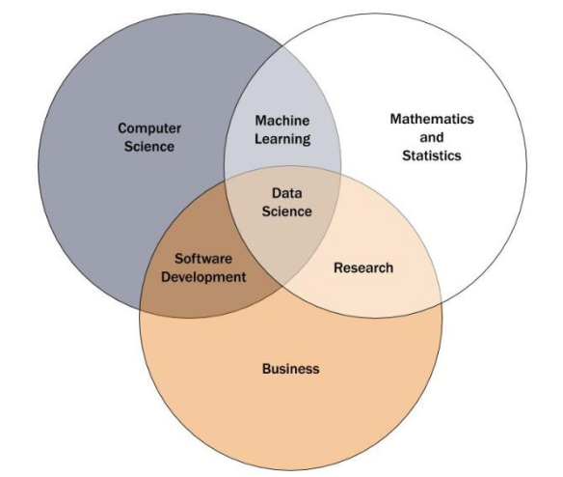
Module No. 1
Data science Definition
It is the study of data and a multidisciplinary approach that combines principles and practices from the fields of
Mathematics,
Statistics,
Artificial Intelligence
Specialized Programming and
Advanced Analytics
to Analyze large amounts of data for extracting meaningful insights for business.

Slide 5
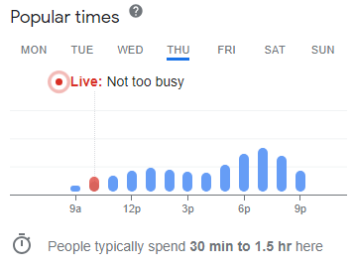
Module No. 1
Ex: How Data Science helps Owners and Customers?
Best timing for purchasing from a store or mall

Slide 6
Module No. 1
Data science encompasses
- preparing data for analysis and processing,
- performing advanced data analysis, and
- presenting the results to reveal patterns and enable stakeholders to draw informed conclusions.
It helps data scientists to ask and answer questions like
what happened,
why it happened,
what will happen, and
what can be done with the results.

Slide 7
Module No. 1
A data scientist must be able to do the following:
Apply mathematics, statistics, and the scientific method
Use a wide range of tools and techniques for evaluating and preparing data—(from SQL to data mining to data integration methods)
Extract insights from data using predictive analytics, AI and ML & DL,
Write applications that automate data processing and calculations
Tell—and illustrate—stories that clearly convey the meaning of results to decision-makers and stakeholders
Explain how these results can be used to solve business problems

Slide 8
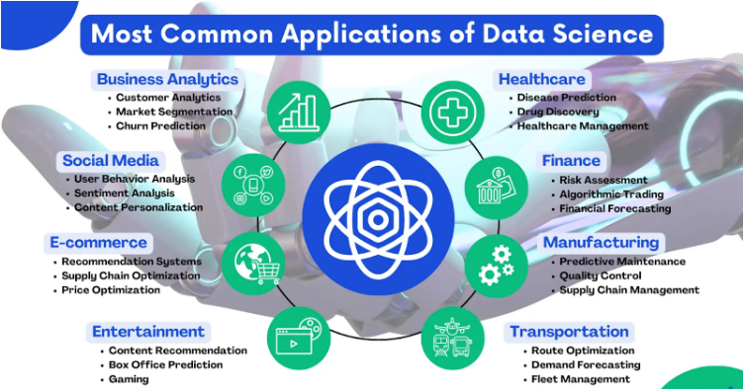
Module No. 1
Applications of Data Science

Slide 9
Module No. 1
Data Science Team
1. Data Engineers: gather, organize and clean the data that data scientists will ultimately use to build their analysis. Build and maintain data infrastructures.
Characteristics
Tech Knowledge
Programming skills
Frequently uses Machine Learning API calls
Familiar with infrastructure architecture
Role
Transforms raw data into usable pipelines
Utilizes advanced programming techniques
Test and deploy Machine Learning models
Manages the data infrastructure

Slide 10
Module No. 1
2. Data Analyst: select and address the business problems that have the most value to the organization.
- present their informed conclusions and recommendations to technical and non-technical stakeholders.
Characteristics
Great communicator and presentation skills
Critical thinking and agile design
Familiar with visualization tools
Role
Domain exploration and understanding
Collect, Understand and Analyze data
Explain and visualize results
Communicate with stakeholders

Slide 11
Module No. 1
3. Data Scientist: perform deeper analysis on the data and developing predictive models to solve more complex data problems.
Characteristics
Is eternally curious - What? Why? How?
Research mindset
Versed in statistics and math
Role
Collect and analyze data
Extract insights from patterns using machine learning models
Explain and visualize results
“A data scientist is a person who is better at statistics than any programmer and better at programming than any statistician.”

Slide 12
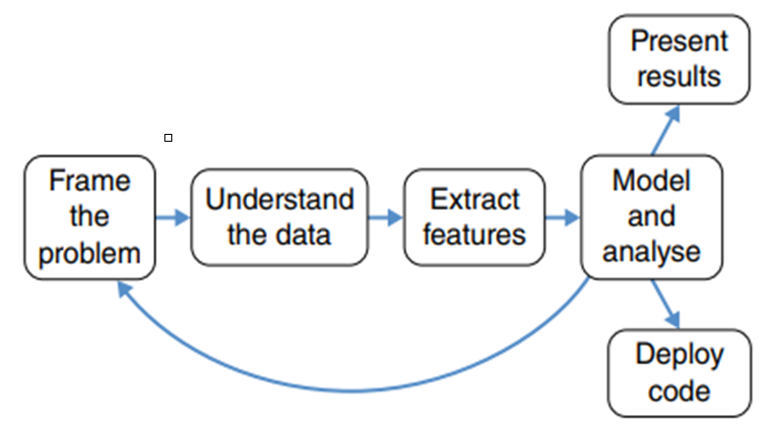
Module No. 1
Data Science – Road Map
Process of solving a data science problem

Slide 13
Module No. 1
Process Steps
Step 1: Understand the Business use case and craft a well‐defined analytics problem
Step 2: Understand the collected data
Step 3: Extract the features from the collected data
Step 4: “Model and Analyze” loops back to framing the problem
Data Scientists will follow the loop back many times, constantly refining methods and producing new insights.
Step 5: Present results from the applied model
Step 6: Deploy the code to run the model

Slide 14
Module No. 1
Frame the Problem
Problem framing
It is setting up business problem in a way that can be addressed with data.
It is the process of taking an abstract goal and translating it into
-what data will be used,
-how the data will look, and
-what modeling approaches might be applicable.
It’s a combination of understanding the underlying mechanics of the problem and matching the problem to techniques and approaches that fit.
Example: If you're analyzing sales data, a basic question could be, "What factors influence sales performance across regions?"

Slide 15
Module No. 1
A “definition of done” is a good way to put it:
what criteria constitute a completed project, and
what would be required to make the project a success?
SOW: “statements of work”
- Writing that document is a collaborative process
- involving with stakeholders, negotiation, and sometimes heated disagreement.
- often include an appendix that describes the available data.

Slide 16
Module No. 1
Understand the Data
Once having access to the data, it’s good to have standard questions that always ask about it.
It a good way to hit the ground running with analysis, rather than risk analysis paralysis.
It is also a good safeguard to identify problems with the data as quickly as possible

Slide 17
Module No. 1
Understand the Data – Basic Questions
A few good generic questions to ask are as follows:
Is the collected data relevant for solving the business problem?
How big is the dataset?
Is this the entire dataset?
Is this data representative enough?
(For example, maybe data was only collected for a subset of users.)
Are there likely to be gross outliers or extraordinary sources of noise? (For example, 99% of the traffic from a web server might be a single denial‐of‐service attack.)

Slide 18
Module No. 1
CONTD..
Is artificial data inserted into the dataset?
Are there any fields that are unique identifiers?
Are the supposedly unique identifiers actually unique?
If there are two datasets A and B that need to be joined, what does it mean if something in A doesn’t matching anything in B?
When data entries are blank, where does that come from?
How common are blank entries?

Slide 19
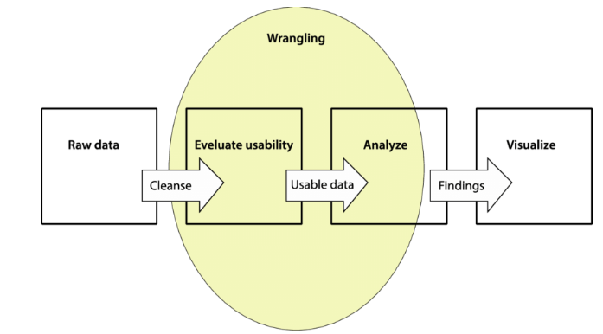
Module No. 1
Understand the Data: Data Wrangling
What is it?: Data wrangling (or cleaning) involves preparing raw data into a format suitable for analysis.
Data wrangling - the process of getting the data from its raw format into something suitable for more conventional analytics.
- Also known as Data Munging.
Notes:
Source: https://www.researchgate.net/figure/Data-wrangling-is-an-iterative-data-exploration-and-transformation-process-which-aims-to_fig1_319560096

Slide 20
Tasks Involved:
  Handling Missing Values: Deciding whether to impute or drop missing data.
  Correcting Data Types: Ensuring the right types (e.g., converting string to numeric).
  Dealing with Duplicates: Removing or consolidating duplicate records.
  Normalization: Scaling numeric data to bring uniformity.
  Tools: Pandas, NumPy (Python), dplyr (R).

Slide 21
Module No. 1
It means creating a software pipeline that
- gets the data out of wherever it is stored,
- does any cleaning or filtering necessary, and
- put it into a regular format.
Specialized tools and Big Data techniques are required to access the specialized DB to get data
use performance tricks to make things run quickly.
Identify the messy data and which can be solved by using suitable solutions
Dataset is broken includes the following:
If the raw data is text, look directly at the plain files in a text editor.
- irregular date formats, irregular capitalizations, and jumbled lines
Make sure that identified tool can able to open and process the data

Slide 22
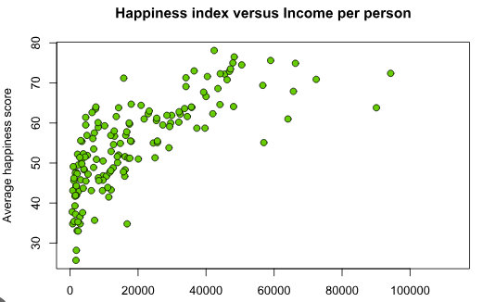
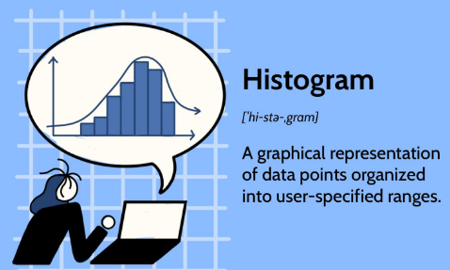
Module No. 1
Do some histograms and scatterplots.
Are these numbers realistic, given what you know about the real‐life situation?
Are there any massive outliers?
Take some simple questions that already know the answer to, answer them based on the data, and see if the results agree.

Slide 23
Module No. 1
Extract Features
“Tabular data” - It means taking raw datasets and distilling them down into a table with rows and columns.
row corresponds to some real‐world entity, and each column gives a single piece of information that describes that entity.
Extracting good features is the most important thing for getting analysis to work.
more important than good machine learning classifiers, fancy statistical techniques, or elegant code.
It is the most creative part of data science and the one most closely tied to domain expertise.

Slide 24
Module No. 1
Data scientists should work with domain experts and understand phenomena mean and how to distill them into numbers.
Extracting more features that will be used to predict something.
Target variable - need to extract the thing that to be predicted

Slide 25

Module No. 1
Extract Features
Exploratory Analysis
It means pushing around in the data,
- visualizing it in lots of different ways, - trying out different ways to transform it, and - seeing what there is to see.
It is an approach that is used to
- analyze the data and discover trends, patterns, or check assumptions in data with the help of statistical summaries and graphical representations
This stage is very creative, and it’s a great place to see the curiosity of people involved.
Notes:
Image Source: https://www.simplilearn.com/tutorials/data-analytics-tutorial/exploratory-data-analysis

Slide 26
Module No. 1
Feel free to calculate some correlations and similar things,
Keep things simple and intuitive.
There are two things that you typically get out of exploratory analysis:
develop an intuitive feel for the data, including what the significant patterns look like visually. This is especially important when working with similar data a lot in the future.
get a list of concrete hypotheses about what’s going on in the data.
A common misunderstanding is that data scientists don’t need visualizations.
Reference Link: https://www.geeksforgeeks.org/data-wrangling-in-python/

Slide 27
Module No. 1
Model
In many data science projects, the modeling stage is quite simple:
- just take a standard suite of models,
- plug your data into each one of them, and
- see which one works best.
-> In other cases, a lot of care is taken to carefully tune a model and seek out every last bit of performance.
Really this should happen at every stage of a data science project
This stage is what allows for course corrections in a project and gives ideas for what to do differently if there is another iteration.

Slide 28
Module No. 1
Present Results
Use slide deck (ppt) or a written report describing the work done and results obtained.
Communication in slide decks and style is a difficult, important skill set in itself.
Data scientists must communicate gracefully with business stakeholders, domain experts, software engineers, and business analysts.
These groups tend to have different knowledge bases coming in, different things they will be paying attention to, and different presentation styles to which they are adapted.

Slide 29
Module No. 1
Deploy Code
- job to produce code that will be run regularly in the future by other people.
Typically, this falls into one of two categories:
Batch analytics code:
- involves storing all the data received until a certain amount is collected and then
processed as a batch
- This data process is scheduled at a specific time.
- Processing a sufficient amount of data.
- used to redo an analysis similar to the one that has already been done,
- it will produce some human‐readable analytics reports.

Slide 30
Module No. 1
Deploy Code
2. Real‐time code:
- This will typically be an analytical module in a larger software package, written in a high‐performance programming language
- once the data available that will be processed and appropriate output or results will be made
- Real-time data processing is immediate and constantly up-to-date
- Real-time integration is carried out at the time of the event.
There are three typical deliverables from this stage:
The code itself.
The Manual to run the code (run book) and
Test code that ensures that code operates correctly.
- Take Unit test for real‐time code.

Slide 31
Module No. 1
Iterating
Data science is a deeply iterative process, even more so than typical software engineering.
generally at least know what you’re ultimately aiming to create, even if you take an iterative approach to writing it
Recommendations
Get preliminary results as quickly as possible
Automate the analysis in a single script so that it’s easy to run the whole thing with one command.
Keep the code modular and broken out into clear stages. This makes it easy to modify, add in, and take out steps as you experiment.

Slide 32
Module No. 1
Dataset
A data set - an ordered collection of data.
Data - A collection of information obtained through
- observations,
- measurements,
- study, or analysis
It could include information such as
- facts,
- numbers,
- figures,
- names, or
- basic descriptions of objects.

Slide 33
Module No. 1
Identify Pathologies
To identify issues early, we have four pieces of advice:
1. If the data is text, look directly at the raw file rather than just reading it into script.
2. Read supporting documentation, if it’s available to understand uses strange codes or conventions.
3. Have a battery of standard analytical questions to ask about the data.
- Does this column contain NULLs?
- Are all the identifiers in table A present in table B, and vice versa? etc.
4. Do sanity checks, where you use the data to derive things that you already know.
Example:
If you count the customers in the dataset and it isn’t equal to the number of customers you know the company has, then chances are you weren’t identifying unique customers correctly.

Slide 34
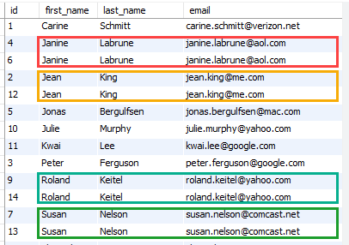
Module No. 1
Problems with Data Content
Duplicate Entries:
- always check for duplicate entries in a dataset
dense them into one entry, adding an additional column that indicates how many unique entries there were.
- the duplication is purely a result of how the data was generated
Multiple Entries for a Single Entity:
Often, each real‐ world entity logically corresponds to one row in the dataset, but some entities are repeated multiple times with different data.
actually should be duplicate entries for an entity when their reports generated with same id in different moments.

Slide 35
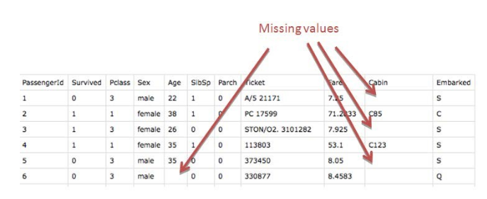
Module No. 1
Missing Entries
Most of the time when some entities are not described in a dataset, they have some common characteristics that kept them out.
Example: let’s say that there is a log of all transactions from the past year. We group the transactions by customer and add up the size of the transactions for each customer. This dataset will have only one row per customer, but any customer who had no transactions in the past year will be left out entirely.

Slide 36
Module No. 1
Decision can be taken: join the derived data up against some known set of all customers and fill in the appropriate values for the ones who were missing.
In other cases, missing data arises because data was never gathered in the first place for some entities. For example, maybe two factories produce a particular product, but only one of them gathers this particular data about them.

Slide 37
Module No. 1
NULLs
NULL entries mean that we don’t know a particular piece of information about some entity.
The question is: why? - because the data collection process was poor in some way
What this means depends on the context. When it comes time to do analytics, NULLs cannot be processed by many algorithms.
In these cases, it is often necessary to replace the missing values with some reasonable proxy.
Most often is that it is guessed from other data fields, or you simply plug in the mean (avg), or mode, or median of all the non‐null values.

Slide 38
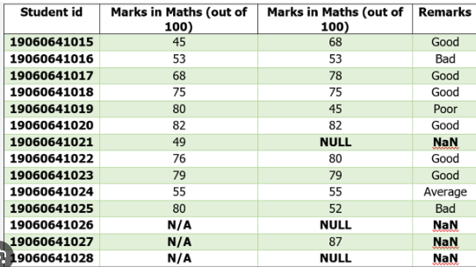
Module No. 1
In other cases, the NULL values arise because that data was never collected.
For example, some measurements might be taken at one factory that produces widgets but not at another.
The table of all collected data for all widgets will then contain NULLs for whenever the widget’s factory didn’t collect that data.
For this reason, whether a variable is NULL can sometimes be a very powerful feature.

Slide 39
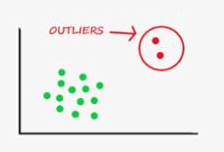
Module No. 1
Huge Outliers
a massive outlier in the data is there because there was truly an abnormal event.
How to deal with that depends on the context.
Sometimes, the outliers should be filtered out of the dataset.
Example: In web traffic when predicting page views by humans, a huge spike in recorded traffic is likely to come from a bot attack, rather than any activities of humans.
In other cases, outliers just mean missing data. Some storage systems don’t allow the explicit concept of a NULL value, so there is some predetermined value that signifies missing data.
Arbitrary or Random values, then this might be what’s happening.

Slide 40
Module No. 1
Out of Date Data
In many databases, every row has a timestamp for when it was entered.
When an entry is updated, it is not replaced in the dataset; instead, a new row is put in that has an up‐to‐date timestamp.
Artificial Entries
Many industrial datasets have artificial entries that have been purposely inserted into the real data.
This is usually done for purposes of testing the software systems that process the data

Slide 41
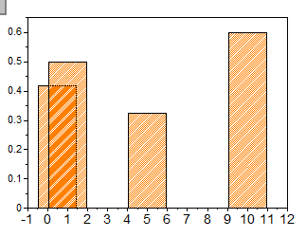
Module No. 1
Irregular Spacings
Many datasets include measurements taken at regular spacing.
Example: Measuring
- network traffic to a website every hour
- temperature of a physical object measured at every inch.
algorithms that process data such as this assume that the data points are equally spaced, which presents a major problem when they are irregular.
Special case of irregular spacings happens
- measurements taken in irregular time intervals
Ex: No regular time intervals followed for assessing the training program

Slide 42
Module No. 1
Formatting Issues
1. Formatting Is Irregular between Different Tables/Columns:
It may be happened because of how the data was stored in the first place.
It is a big issue when joinable / groupable keys are irregularly formatted between different datasets
2. Extra Whitespace:
Extra whitespaces increase the size of data and trouble in analyzing the data like ‘Comparison Failures’.
Ex: “ MCA” != “MCA”
In Python, every string object has a strip() method that removes whitespace from the front and end of a string.

Slide 43
Module No. 1
The methods lstrip() and rstrip() will remove whitespace only from the front and end, respectively.
If you pass a character as an argument into the strip functions, only that character will be stripped.
For example,
>>> “ ABC\t".strip() ‘ABC'
>>> " ABC\t".lstrip() 'ABC\t'
>>> " ABC\t".rstrip() ' ABC'
>>> "ABC".strip("C") 'AB’

Slide 44
Module No. 1
3. Irregular Capitalization:
It creates Inconsistent Data, where the same string repeated with different capitalization format.
Example: Jain, jain, jAin, JAIn
- Python strings have lower() and upper() methods, which will return a copy of the original string with all letters set to uppercase or lowercase.
4. Inconsistent Delimiters:
Usually, a dataset will have a single delimiter, but sometimes, different tables will use different ones.
The most common delimiters:
● Commas ● Tabs ● Pipes (the vertical line “|”)

Slide 45
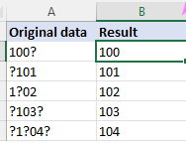
Module No. 1
5. Irregular NULL Format:
There are a number of different ways that missing entries are encoded into CSV files, and they should all be interpreted as NULLs when the data is read in.
Some popular examples are the empty string “”, “NA,” and “NULL.”
Occasionally, you will see others such as “unavailable” or “unknown” as well.
6. Invalid Characters:
Some data files will randomly have invalid bytes in the middle of them.
Some programs will throw an error if you try to open up anything that isn’t valid text.

Slide 46
Module No. 1
7. Incompatible Date times:
Datetimes are one of the most frequently confused types of data field.
Some of the date formats you will see are as follows:
● August 1, 2013 ● AUG 1, ‘13 ● 2013‐08‐13
if two different ways of expressing the same information, and a perfect translation is possible from the one to the other.
But with dates and times, the information content itself can be different.
If time is included with date.
Decision to be taken:
- If there is a time, does it go out to the minute, hour, second, or something else?
- What about time zones?

Slide 47
Module No. 1
8. Operating System Incompatibilities:
Different operating systems have different file conventions,
sometimes, that is a problem when opening a file that was generated on one OS on a computer that runs a different one.
Probably, the most notable place where this occurs is newlines in text files.
In Mac and Linux, a newline is conventionally - denoted by the single character “\n.”
On Windows, it is often two characters - “\r\n.”
Many data processing tools check what operating system they are being run on so that they know which convention to use.

Slide 48
Module No. 1
9. Wrong Software Versions:
Data error could be happened when opening file made by using earlier version in new version of the software.
Associated versions of software for accessing dataset is feasible to avoid data loss.

Slide 49
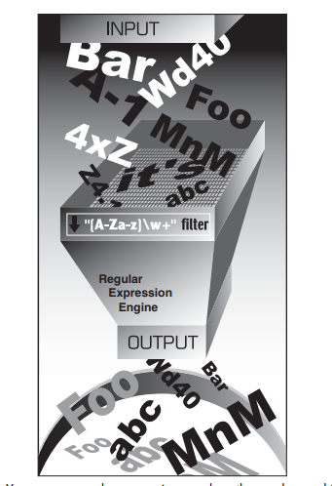
Module No. 1
Regular Expressions
A regular expression (rational expression) :
a sequence of characters that define a search pattern,
mainly for use in pattern matching with strings, or string matching, i.e. “find and replace”-like operations.
Regular expressions are a generalized way to match patterns with sequences of characters.
It is used in every programming language like C++, Java and Python.
REs are simply strings that use special symbols and characters
Example:
‘‘[A-Za-z]\w+ ” means
the first character should be alphabetic, i.e., either A–Z or a–z,
followed by at least one (+) alphanumeric character (\w).

Slide 50
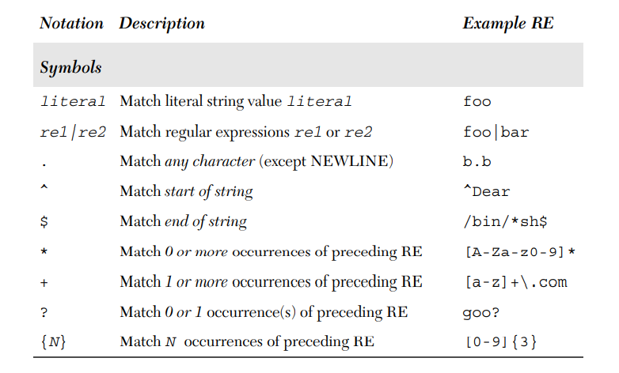
Module No. 1
Metacharacters – characters with special meaning

Slide 51
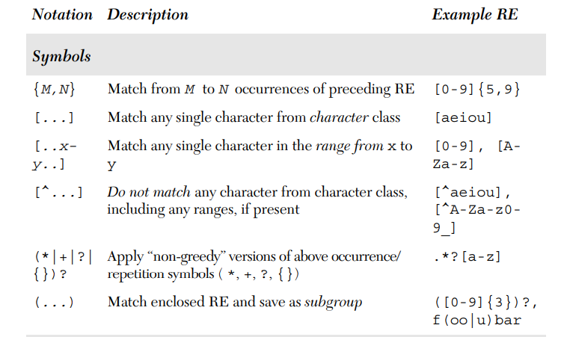
Module No. 1

Slide 52
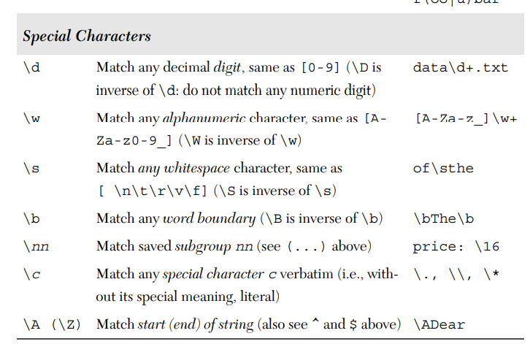
Module No. 1

Slide 53
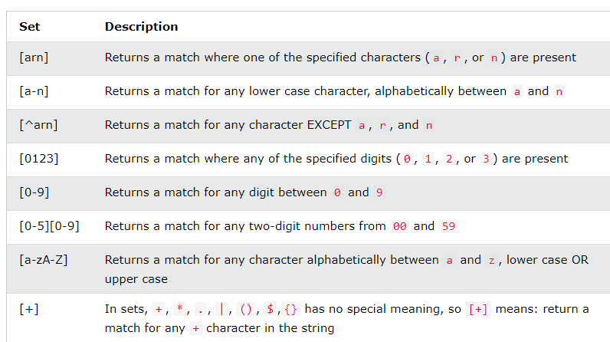
Module No. 1
Sets
- a set of characters inside a pair of square brackets [] with a special meaning
Reference link for demo: https://www.w3schools.com/python/python_regex.asp

Slide 54
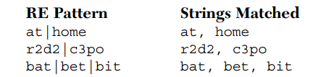
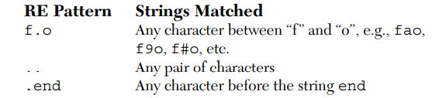
Module No. 1
Examples:
Matching More Than One RE Pattern with Alternation ( | ) – Pipe Symbol
- indicates an alternation operation, meaning that it is used to choose from one of the different regular expressions
Matching Any Single Character ( . )
matches any single character except for NEWLINE

Slide 55
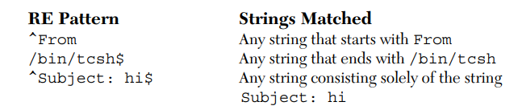
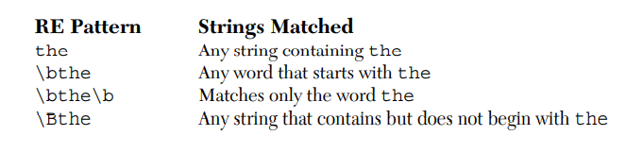
Module No. 1
Matching from the Beginning or End of Strings or Word Boundaries ( ^/$ /\b /\B )

Slide 56
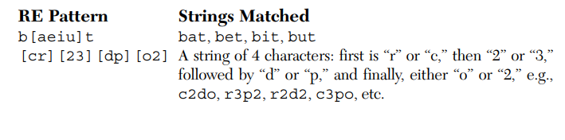
Module No. 1
Creating Character Classes ( [ ] )
- to match specific characters
Denoting Ranges ( - ) and Negation ( ^ )
- A hyphen between a pair of symbols enclosed in brackets is used to indicate a range of characters
e.g., A–Z, a–z, or 0–9 for uppercase letters, lower case and numbers
- caret ( ^ ) - symbolizes a directive not to match any of the characters in the given character set.

Slide 57
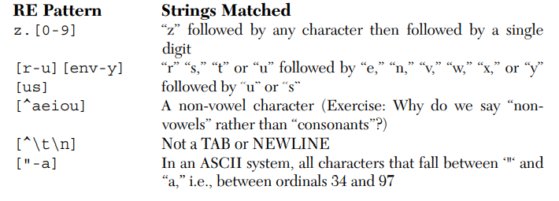
Module No. 1
Multiple Occurrence/Repetition Using Closure Operators ( * , +, ?, { } )
- which can be used to match single, multiple, or no occurrences of string patterns
- asterisk or star operator ( * ) will match exactly 0 or 1 occurrences of an RE
- brace operators ( { } ) indicate a match of exactly N occurrences or a range of occurrences

Slide 58
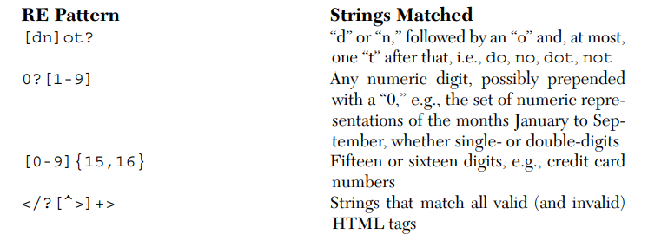
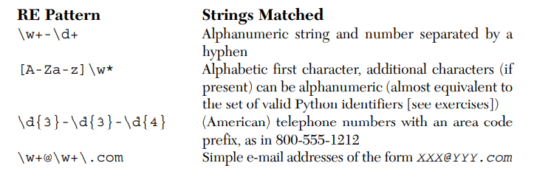
Module No. 1
Special Characters Representing Character Sets
“\d” - to indicate the match of any decimal digit
“\w” - to denote the entire alphanumeric character class
“\s” - for whitespace characters
“\D” - matches any non-decimal digit

Slide 59
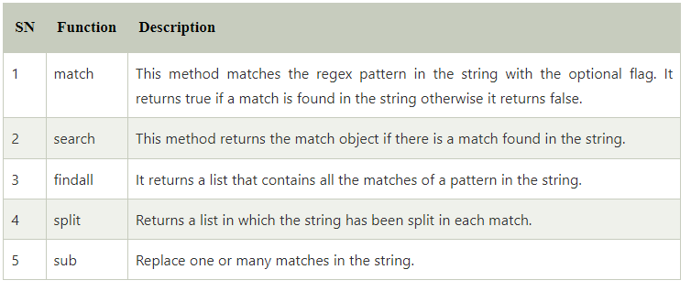
Module No. 1
RE(Regular Expressions) and Python
Functions for Regular Expressions:

Slide 60
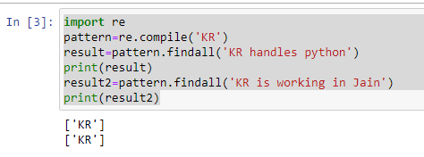
Module No. 1
Import re module to perform regular expression operations in python
re Module: Core Functions and Methods:
re.compile(pattern)
-combine a regular expression pattern into pattern objects, which can be used for pattern matching
-also helps to search a pattern again without rewriting it

Slide 61
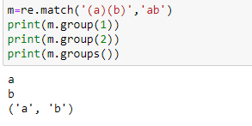
Module No. 1
re.findall() function
-returns a list containing a list of all matches of a pattern within the string
-If there are no matches, then an empty list is returned.
re.match()
-function of re in Python will search the regular expression pattern and return the first occurrence.

Slide 62
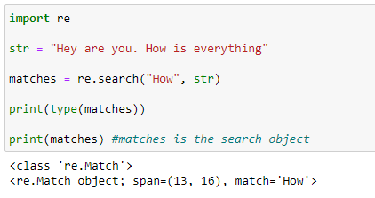
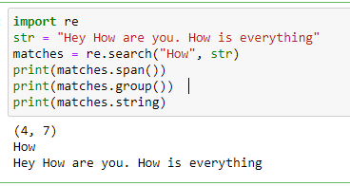
Module No. 1
re.search() method
returns the match object if there is a match found in the string.
Methods associated with the Match object
span(): It returns the tuple containing the starting and end position of the match.
string: It returns a string passed into the function.
group(): The part of the string is returned where the match is found.

Slide 63
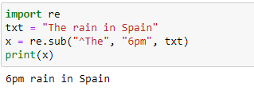
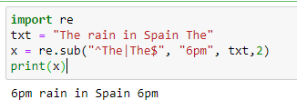
Module No. 1
Search and Replace
re.sub(pattern, repl, string, max=0)
replaces all occurrences of the RE pattern in string with repl, substituting all occurrences unless max provided.
This method returns modified string

Slide 64
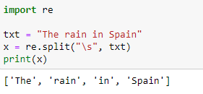
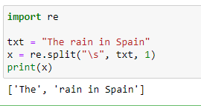
Module No. 1
split(pat,string,max) function returns a list where the string has been split at each match

Slide 65
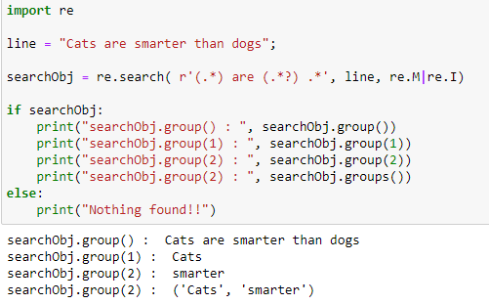
Module No. 1
group(num=0)
This method returns entire match (or specific subgroup num)
groups()
This method returns all matching subgroups in a tuple

